Slide 1
Session Management –II
Waqar Yar

Slide 2
Cookies
Cookie is data sent by the server to the client.
It is a name\value pair sent in the response object.
Cookies are deleted when the Client closes a browser
Cookies can be set not to be deleted as well.

Slide 3

Cookie creation
Creating a new Cookie:
Setting how long the cookie will live:

Slide 4
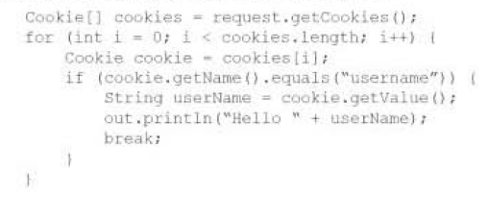
Cookie creation
Getting a cookie from the client request:

Slide 5
Session Migration.
When a session is moved from one JVM to another session migration is done.
The Container could do Load Balancing, where one session is sent to another JVM.

Slide 6
Session Migration.
Only HtpSession objects and their attributes move from one VM to another.
One ServletContext, per JVM
One ServletConfig per JVM.

Slide 7
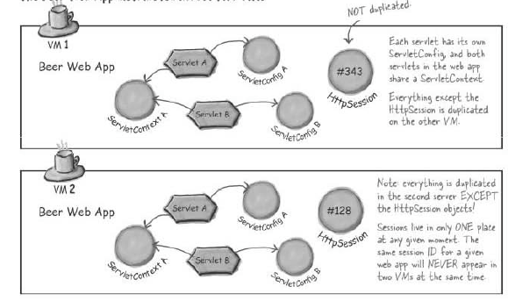

Slide 8
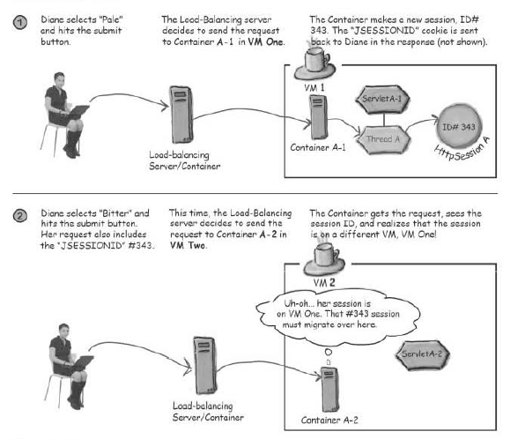

Slide 9
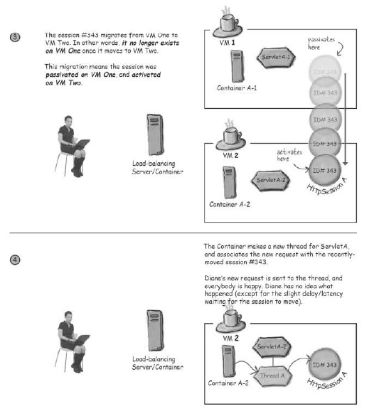

Slide 10
Serialization .
To serialize an object means to convert its state to a byte stream so that the byte stream can be reverted back into a copy of the object.
A Java object is serializable if its class or any of its superclasses implements either the java.io.Serializable interface or its subinterface, java.io.Externalizable.
Deserialization is the process of converting the serialized form of an object back into a copy of the object.

Slide 11
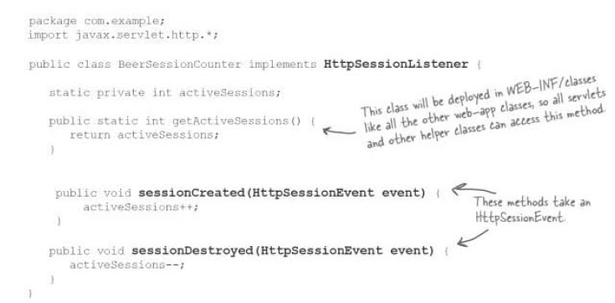
Listener examples

Slide 12
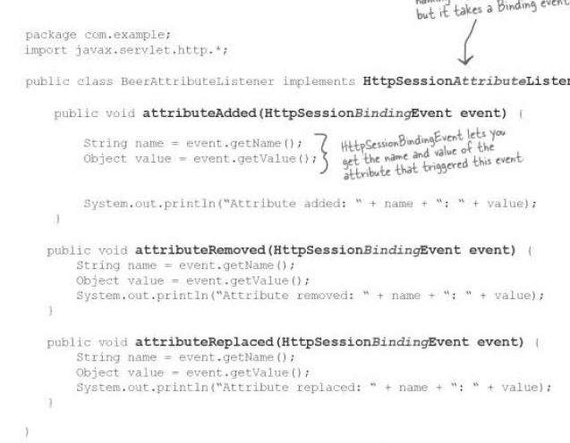
Attribute Listener

Slide 13
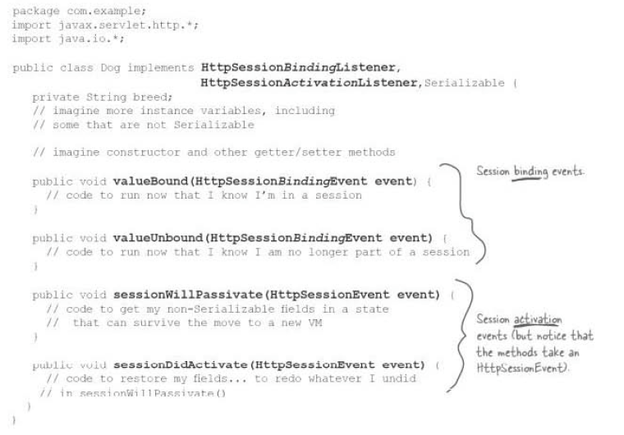
Attribute Class Listening for and Event

Slide 14
What is a JSP?
JavaServer Pages (JSP) is a technology that helps software developers create dynamically generated web pages based on HTML,XML, or other document types.
JSP is Java code inside an HTML page.
The JSP file is translated into .java file. Then the .java file is compiled into a servlet class file.

Slide 15
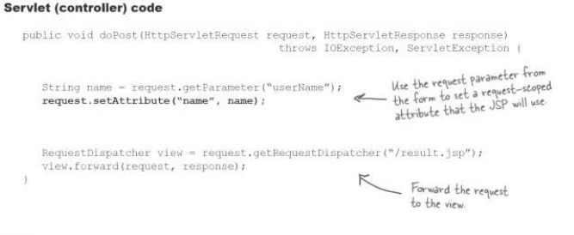
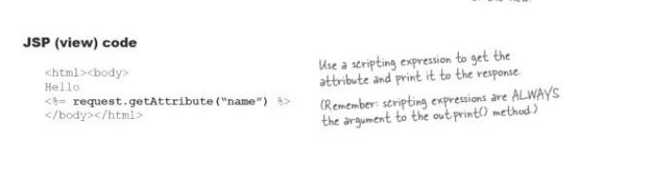
Controller Example

Slide 16
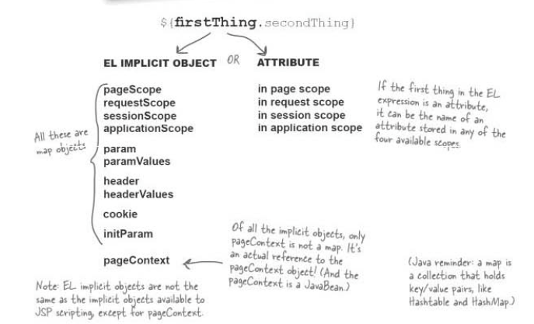
Understanding EL variable.

